Slide 1

Internship Seminar(15CS84) On CCNA ROUTING AND SWITCHING Internship Carried out at Karnataka German Technical Training Institute(KGTTI)
VIVEKANANDA INSTITUTE OF TECHNOLOGY
DEPARTMENT OF COMPUTER SCIENCE AND ENGINEERING
Under The Guidance Of
Mrs. Chandramma R
Assoc. Professor
Dept. of CSE, VKIT
Naveen Pandurangi
1vk15cs034
Dept. Of CSE, VKIT

Slide 2
ABOUT THE INSTITUTE
Karnataka German Multi Skill Development Centre (KGMSDC), a Society promoted by Government of India and Government of Karnataka with technical support of German International Services (GIZ-IS) has set up Karnataka German Technical Training Institute (KGTTI) having centres at Bengaluru and Gulbarga. The society was headed by the Chief Secretary of the Karnataka State.
To develop KGMSDCs as world class training centres that offer specialized skills training programs in alignment with the Industry requirements in Karnataka and beyond.
KGMSDCs will generate high quality skilled manpower in close association with the industry, while operating with operational flexibility and striving financial self-sustainability

Slide 3
Contents
Overview
Introduction
Routing and Switching Essentials
Routing Table
Static Routing
Dynamic Routing
Switched Networks
Scaling Networks
Types of VLANs
OSPF

Slide 4
Overview of CCNA Routing and Switching
Cisco Certified Network Associate (CCNA) Routing and Switching.
It is a certifications program for entry-level network engineers.
CCNA Routing and Switching is for:
Network Specialists
Network Administrators, and
Network Support Engineers with 0-3 years of experience.
The CCNA Routing and Switching validates:
The ability to install
Configure
Operate and troubleshoot medium-size routed and switched networks.

Slide 5
Introduction
What is
Network?
Internet?
Routing?
Switching?
Different forms of communication:
Texting
Social Media
Blogs
Wikis
Podcasting etc..
Categories of network components
Devices
Media
Services

Slide 6
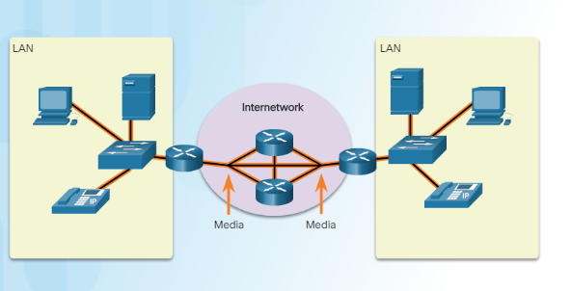
Components of Network-Media
Three types of Media to interconnect devices:
Metallic wires within cables.
Glass or plastic fibers.
Wireless transmission.

Slide 7
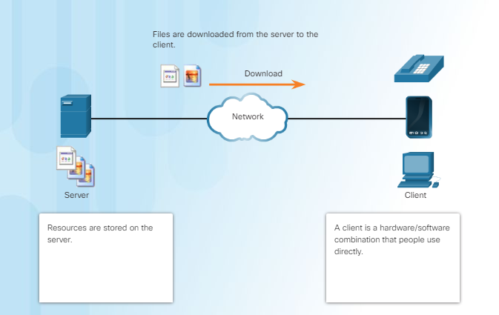
Client Server Model
Device requesting the information is called a client.
Device responding to the request is called a server.
Client and server processes are considered to be in the application layer.

Slide 8
HTTP and HTTPS
HTTP is a request/response protocol.
The three common message types are:
GET: A client (web browser) sends the GET message to the web server to request HTML pages.
POST: Uploads data files to the web server such as form data.
PUT: Uploads resources or content to the web server such as an image.
For secure communication across the Internet, (HTTPS) protocol is used.
Data stream is encrypted with Secure Socket Layer (SSL) before being transported across the network.

Slide 9
TCP Protocol
Features:
Establishing a session.
Reliable Delivery.
Same- order delivery.
Flow control.
Uses Three - way Handshake Analysis.

Slide 10
UDP Protocol
Features:
UDP is considered a best-effort transport protocol.
Lightweight transport protocol
UDP is a simple protocol

Slide 11
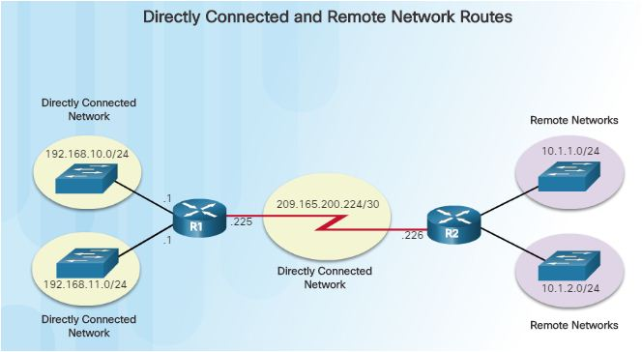
Routing Table
The routing table stores information about:
Directly connected Routes: These routes come from the active router interfaces.
Remote Routes: These are remote networks connected to other routers

Slide 12
Types Of Routing
Static Routing:
Static routes are manually configured.
They define an explicit path between two networking devices
Dynamic Routing:
Allows the routers to automatically learn about the networks from other routers.
Its protocols are used by routers to share information about the reachability and status of remote networks.

Slide 13
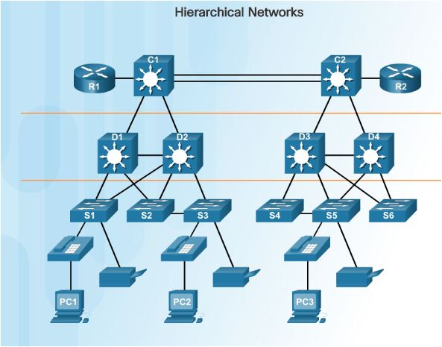
Switched Network
LAN switches provide the connection point for end users into the enterprise network.
Switched LAN features:
Allows more flexibility
Traffic management
Quality of service
Additional security
Support for wireless networking and connectivity.

Slide 14
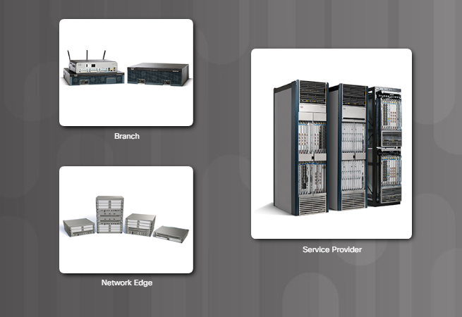
Cisco Routers
Branch Routers
Network Edge Routers
Service Provider Routers

Slide 15
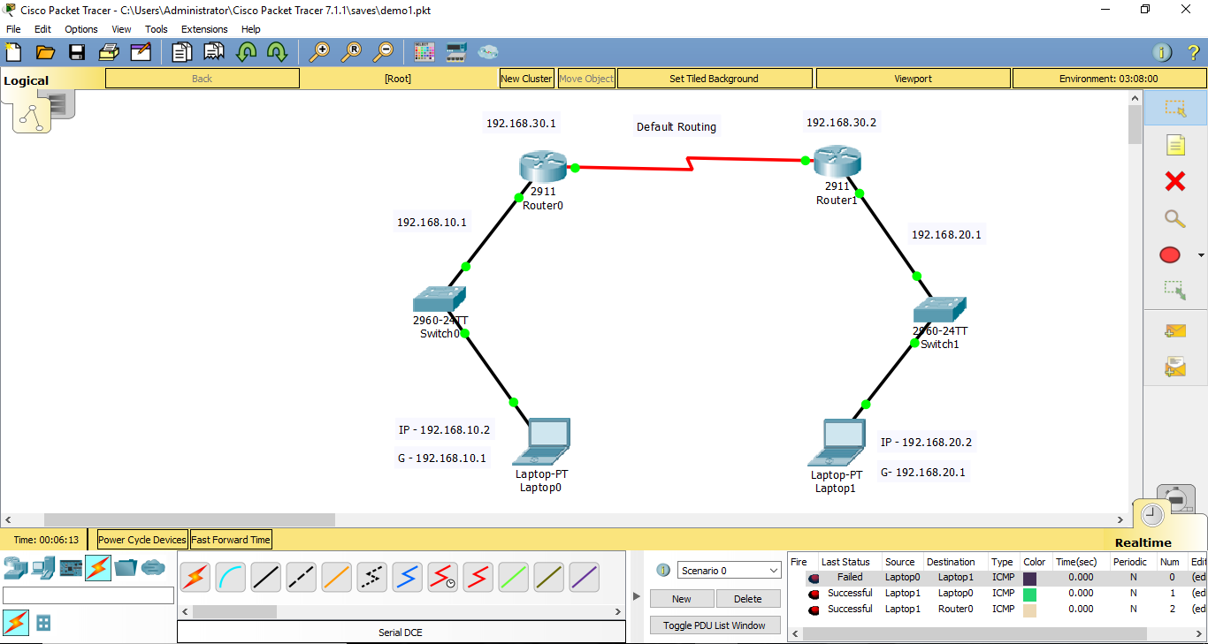
Snapshots
Default route which is also known as the gateway of last resort, whose destination address does not match any route in the routing table.
Default Routing

Slide 16
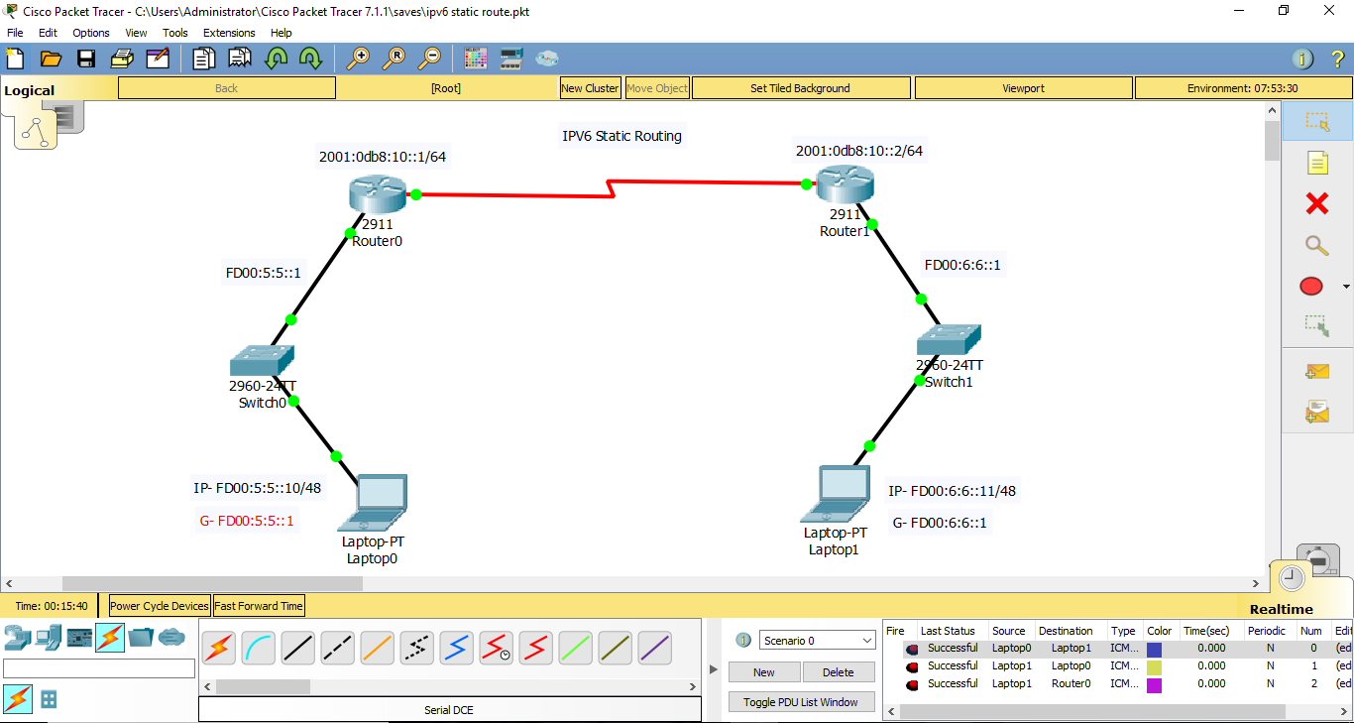
IPV6 Static Routing
IPv6 Static Routing feature provides static routing for IPv6. Static routes are manually configured and define an explicit path between two networking devices.

Slide 17
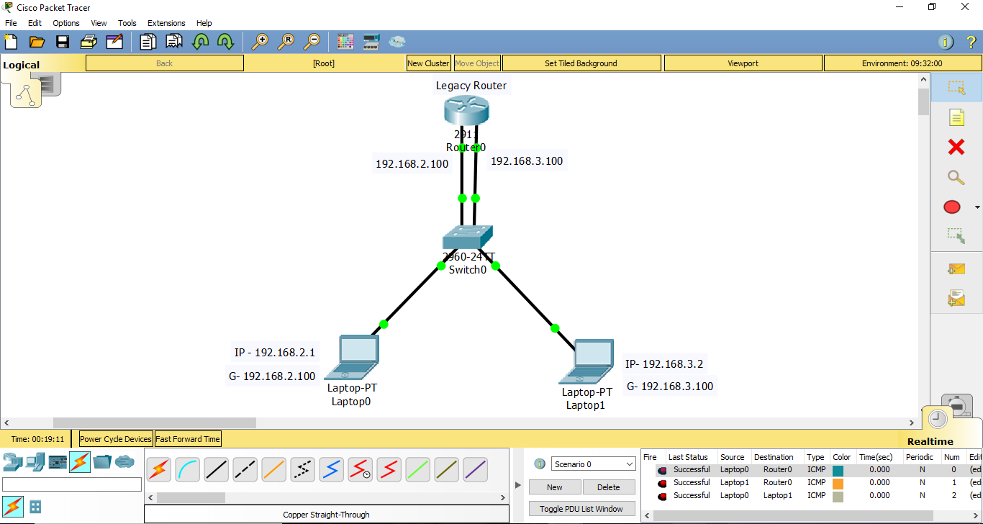
Legacy Router
In legacy approach, inter-VLAN routing is performed by connecting different physical router interfaces to different physical switch ports.

Slide 18
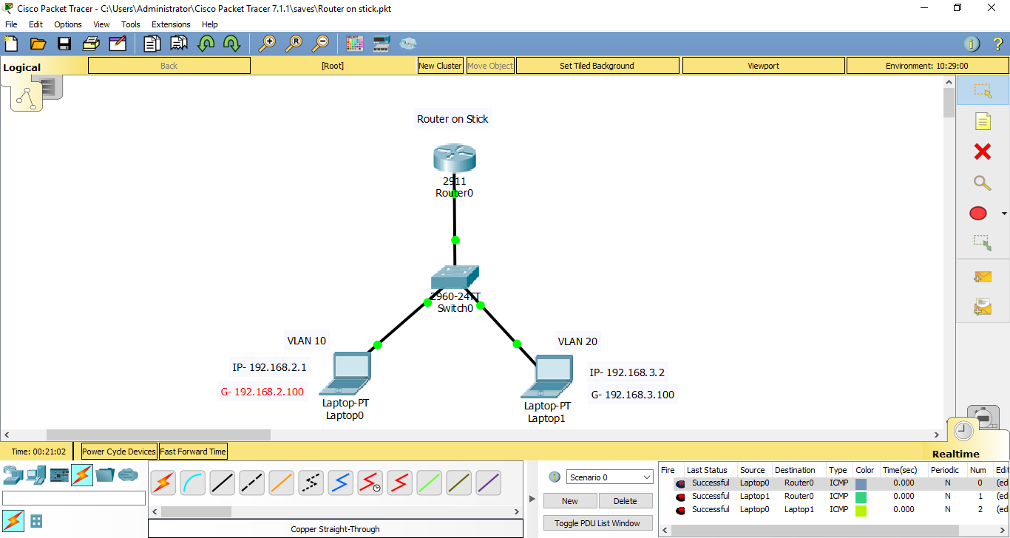
Router on stick
Router and switch connected using one Ethernet link configured as an 802.1q trunk link.

Slide 19
Conclusion
In conclusion, it has been a reality fulfilling internship experience here at KGTTI not only gaining practical knowledge and real-life experience of branding and dealing with real clients, have also managed to develop relationships with my colleagues and honed my social skills.
It also helps that my supervisor seldom directs me or oversees my work after the few days, learning to deal with other colleagues and clients by myself, and I am not protected or shielded from the reality of the working world
I believe that the knowledge and experience gained through this time at KGTTI would come in handy and be able to put to good use upon my graduation, as it has opened up another possible carrier route for me.

Slide 20
References
[1] Andrew S Tanenbaum, Computer Networks, fifth edition, Pearson.
[2] Behrouz A Forouzan, Data and Communications and Networking, Fifth
Edition, McGraw Hill, Indian Edition.
[3] James F Kurose and Keith W Ross, Computer Networking, A Top-Down
Approach, Sixth edition, Pearson, 2017.
[4] Larry L Peterson and Brusce S Davie, Computer Networks, fifth edition,
ELSEVIER.
[5] Mayank Dave, Computer Networks, Second edition, Cengage Learning.
Websites Referred:
[1] https://www.netacad.com.
[2] https://www.kgtti.com

Slide 21
Thank You

